Slide 1
Extreme Chess

Slide 2
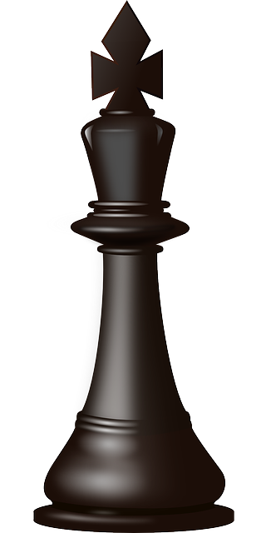
Purpose
To add new strategy to the classic game of chess while reinventing it to appeal to a wider variety of people

Slide 3
Features
Two-player, desktop game of chess
Power-ups to alter the way pieces move
Graveyard to track lost pieces
List of previous moves

Slide 4
Demo
Main Menu
Click New Game
Enter player names
Open and look through Help
Move a few pieces
Activate a power-up and move that piece
Fast forward to king in check then checkmate
Show end game screen
Insert video here

Slide 5
Technical Details
Created using the Unity 5 Engine
Scripts coded in C#
Playable on Windows 10

Slide 6
Group Members
Kyle Sarre Main game logic Piece movement Check logic | Robert Anderson Game design Check logic Power-up implementation | Gabriel Davis Documentation | Hanna Cunningham UI design UI programming Power-up design | Julian Plaisance UI design UI programming

